Slide 1


CS Bridge, July 1, 2021
For Loops, Deconstructed
Notes:
[1:0]

Slide 2
Review Review Review Review Review Review
Notes:
[0:20; 1-2]

Slide 3
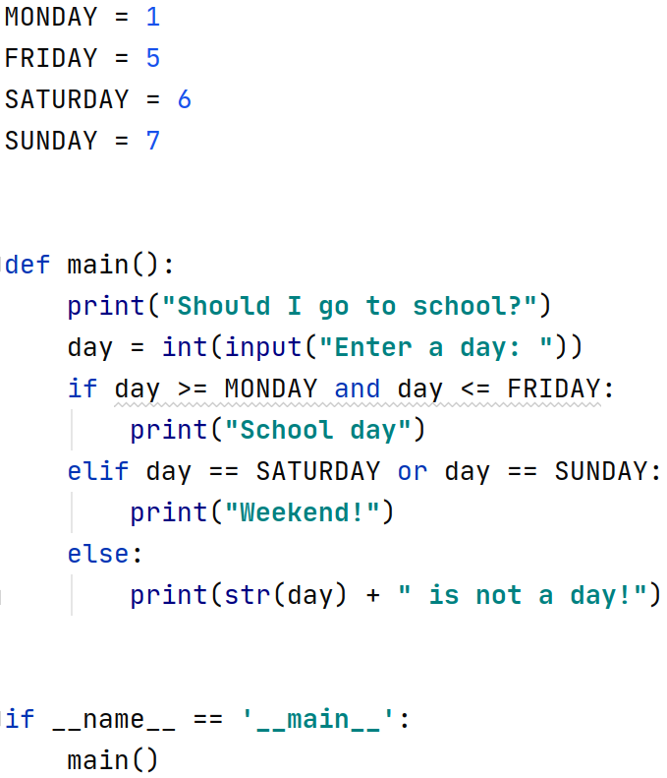

Slide 8
Operator | Example | Result
not | not (2 == 3) | True
and | (2 == 3) and (-1 < 5) | False
or | (2 == 3) or (-1 < 5) | True
Notes:
udělat komplikovanou složenou podmínku

Slide 9
Any Questions So Far?
If questions now or anytime ask them in chat, or on ed.
Notes:
[0:30; 7-8]

Slide 10
num1 = num1 + 1 same as num1 += 1 num2 = num2 - 4 same as num2 -= 4 num3 = num3 * 2 same as num3 *= 2 num1 = num1 / 2 same as num1 /= 2 Generally: variable = variable operator (expression) is same as: variable operator= expression
Review: Expression Shorthands
number = number * 2 same as number *= 2
Notes:
[0:30; 7-8]

Slide 11
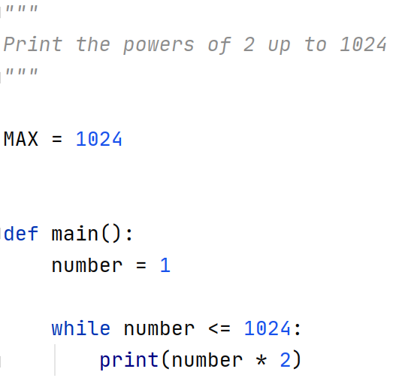

Slide 12


Slide 13
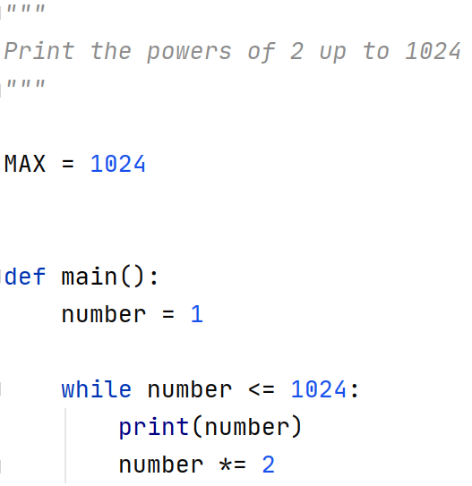
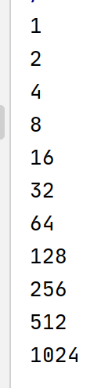

Slide 14
For Loops
Notes:
[0:30; 7-8]

Slide 15

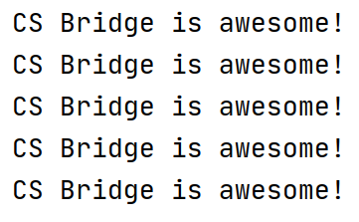
Notes:
[0:30; 8-9]
fixed number of repeats
for loop is much more powerful

Slide 16
index variable
Notes:
[0:30; 9-10]
variable
different name

Slide 17

Notes:
[0:30; 10-11]
any variable name is ok. Let’s stick with i.
what is the value of the variable?

Slide 18
What is the value of the index variable?
Notes:
[0:30; 10-11]
any variable name is ok. Let’s stick with i.
what is the value of the variable?

Slide 19

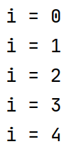
Notes:
[1:30; 11-12]
the 5 is not among the values
it starts from zero
ends before 5

Slide 20
Can the range be an expression?
Notes:
[1:30; 11-12]
the 5 is not among the values
it starts from zero
ends before 5

Slide 21
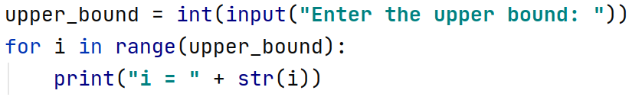
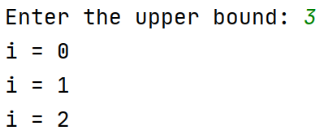
Notes:
[1:0; 12-13]
the range can also contain a variable
we can ask the user to enter the upper bound

Slide 22
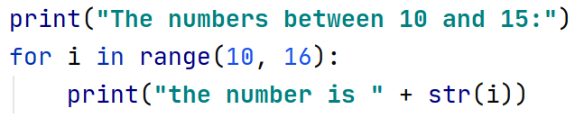
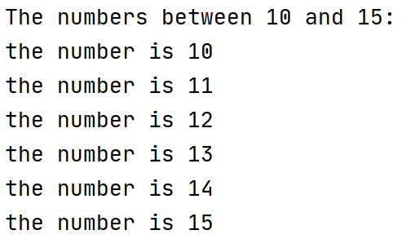
Notes:
[1:0; 13-14]
print the numbers between 10 and 15
we need to start from 10, not from 0
range: two arguments
comma
16 not 15

Slide 23
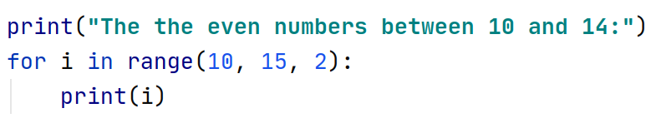
Notes:
[1:0; 14-15]
let’s trace it

Slide 24
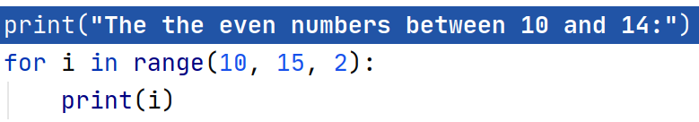
Notes:
[0:15; 15-16]

Slide 25
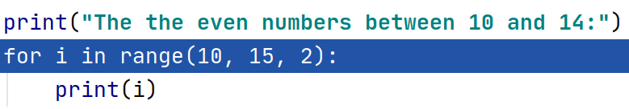
Notes:
[0:15; 15-16]

Slide 26
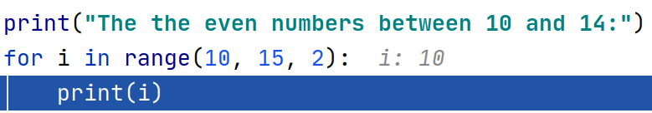
Notes:
[0:15; 15-16]

Slide 27
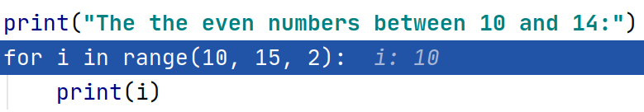

Notes:
[0:15; 16-17]

Slide 28
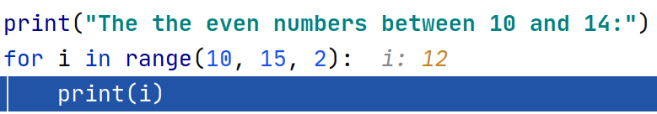
Notes:
[0:15; 16-17]

Slide 29

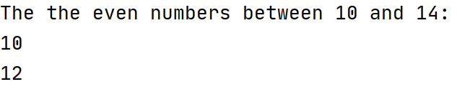
Notes:
[0:15; 16-17]

Slide 30

Notes:
[0:15; 17-18]

Slide 31

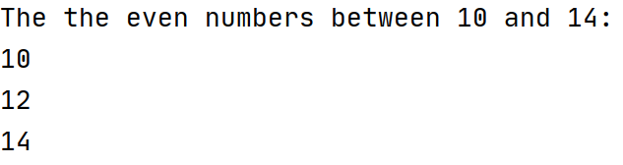
Notes:
[0:15; 17-18]

Slide 32
What about the odd numbers between 10 and 14?
Notes:
[0:15; 18-19]

Slide 33
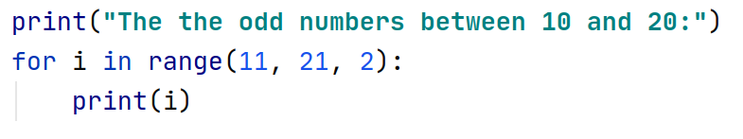
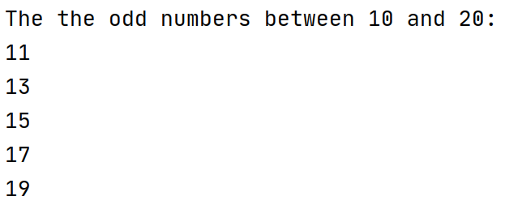
Notes:
[1:0; 19-20]

Slide 34
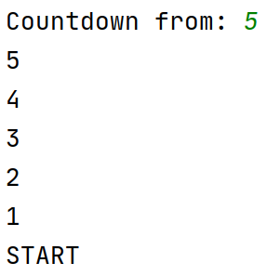
How to do a countdown?
Notes:
[2:0; 20-22]
More complex program
think about it for 1 minute

Slide 35
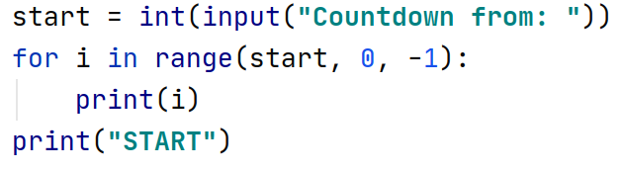
Notes:
[1:0; 22-23]

Slide 36

i = 0, 1, 2, …, N−1
Notes:
[1:0; 23-24]

Slide 37

i = M, M+1, M+2, …, N−1
Notes:
[0:30; 24-25]

Slide 38

i = M, M+S, M+2S, M+3S, …
i < N
Notes:
[1:0; 25-26]

